Slide 1

Healthy Programming
MAHA | Team 3 | Polina Buvaylo, Lance Kirk, Ryan Reyes, Zaid Zeidan

Slide 2
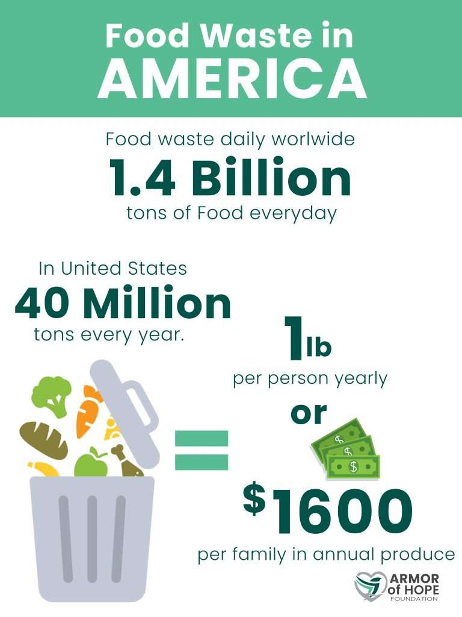
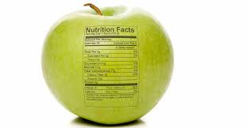
Project Goals
Our program solves the problem of food waste
Aids in reducing the average 120 billion pounds of food waste
Healthy eating/calorie counting

Slide 3

Description
Our program
Asks users to input what ingredients they would like to make a dish with
Asks users their preferred calorie min and max per serving
Program sends user 5 recipes and their nutritional information (calories, protein, fats, sodium, and sugar)
User is given the option to open a recipe link in their browser
Once search is complete user has the option to run code again

Slide 4


Use Cases
Environmentally Conscious
&
Diet and Health

Slide 5

Technology
Recipe Search and Diet API by Edamam
Python Modules
Request Webbroswer
Notes:
https://stock.adobe.com/search?k=programming
API
Recipe Search and Diet API by Edamam
Allows users to search millions of receipts by ingredients and calories
Python Modules
Request
Allows user to interact with information on the internet
Webbroswer
Allows user to open links provided so that they could easily access ingredients and steps

Slide 6

Program Flow
Enter ingredients
Enter min number of calories
Enter max number of calories
Pick option
Repeat if needed

Slide 7
Document One Error Encountered
We were having problems with the calorie input for users.
We addressed this issue by including user input for their min and max calorie goals. And used an if else statement to check input validity

Slide 8
Team Members
Lance
Made sure the code is user-friendly
Worked on user input
Polina
Worked on the nutritional data portion
Worked on intro/ code loop
Ryan
Worked on web browser module
Comments
Zaid
Worked on inputting ingredients in tuple format.
Sources
All
General code writing/ API research
PowerPoint

Slide 9
Related Documents
https://rapidapi.com/edamam/api/recipe-search-and-diet
https://www.geeksforgeeks.org/enumerate-in-python/
https://docs.python.org/3/library/webbrowser.html
Image link
https://armorofhopefoundation.org/zero-waste/
https://us.supersmart.com/en/blog/slimming-weight-control/food-combining-diet-principles-benefits-practical-advice-s268
https://greentec.eu/sustainability/
https://lokker.com/best-data-privacy-software/
https://ventoxmagazine.co.uk/how-the-pr-ad-48-760-35zmhy/

Slide 10

Questions?

